Slide 1
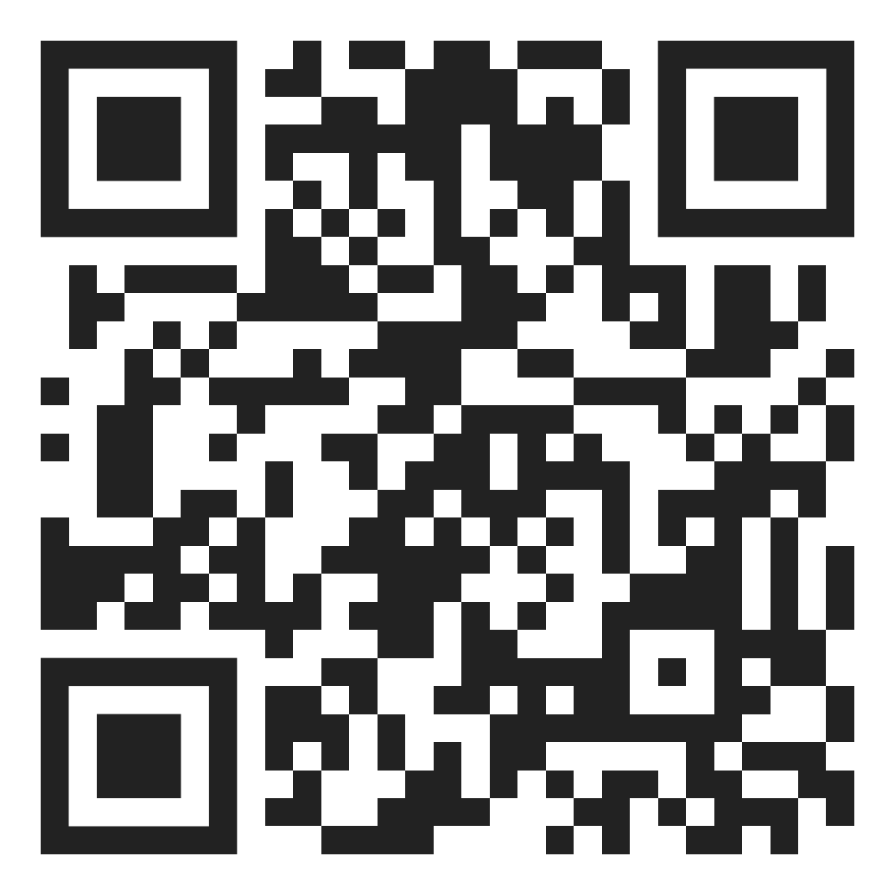
Work With Us!
Credentialed Teachers — Earn clock hours and documentation of professional development
Anyone with Language Proficiency - Brush up or expand your skills with 14 different language options
Room & Board Provided - Enjoy culturally authentic dining during your stay

Slide 2
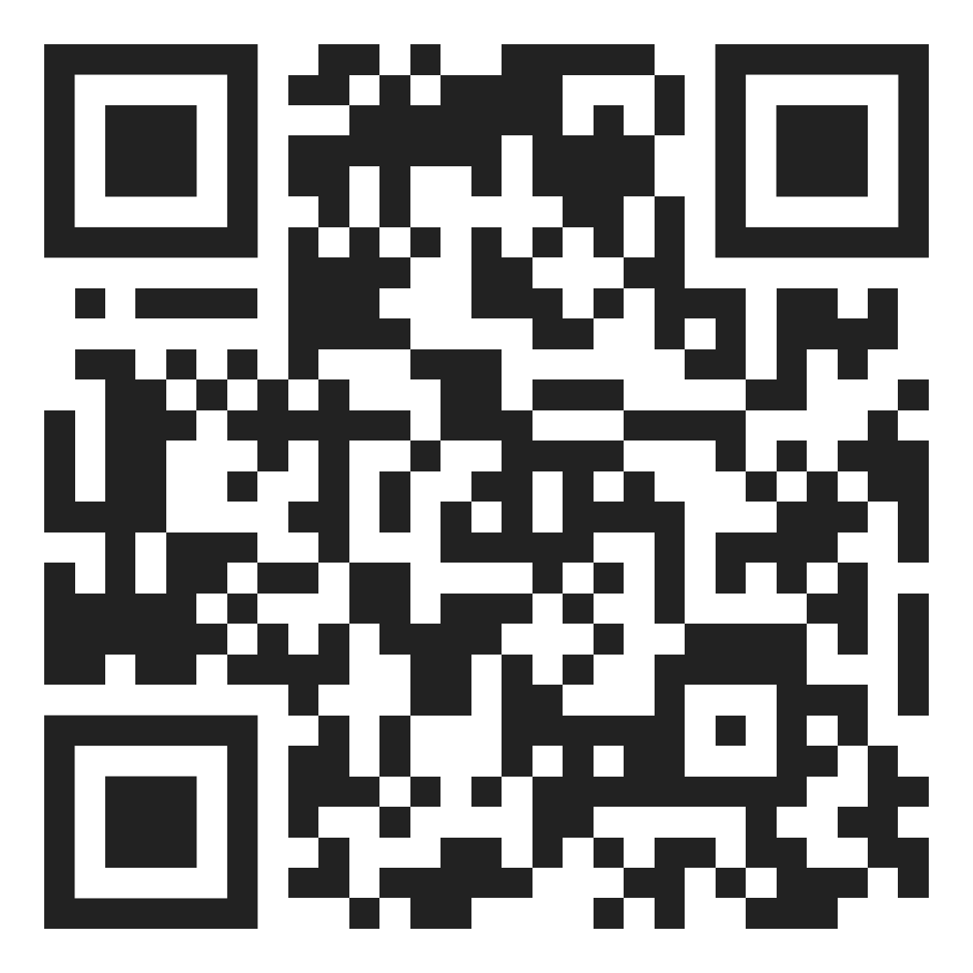
Newsletter Sign Up

Slide 3
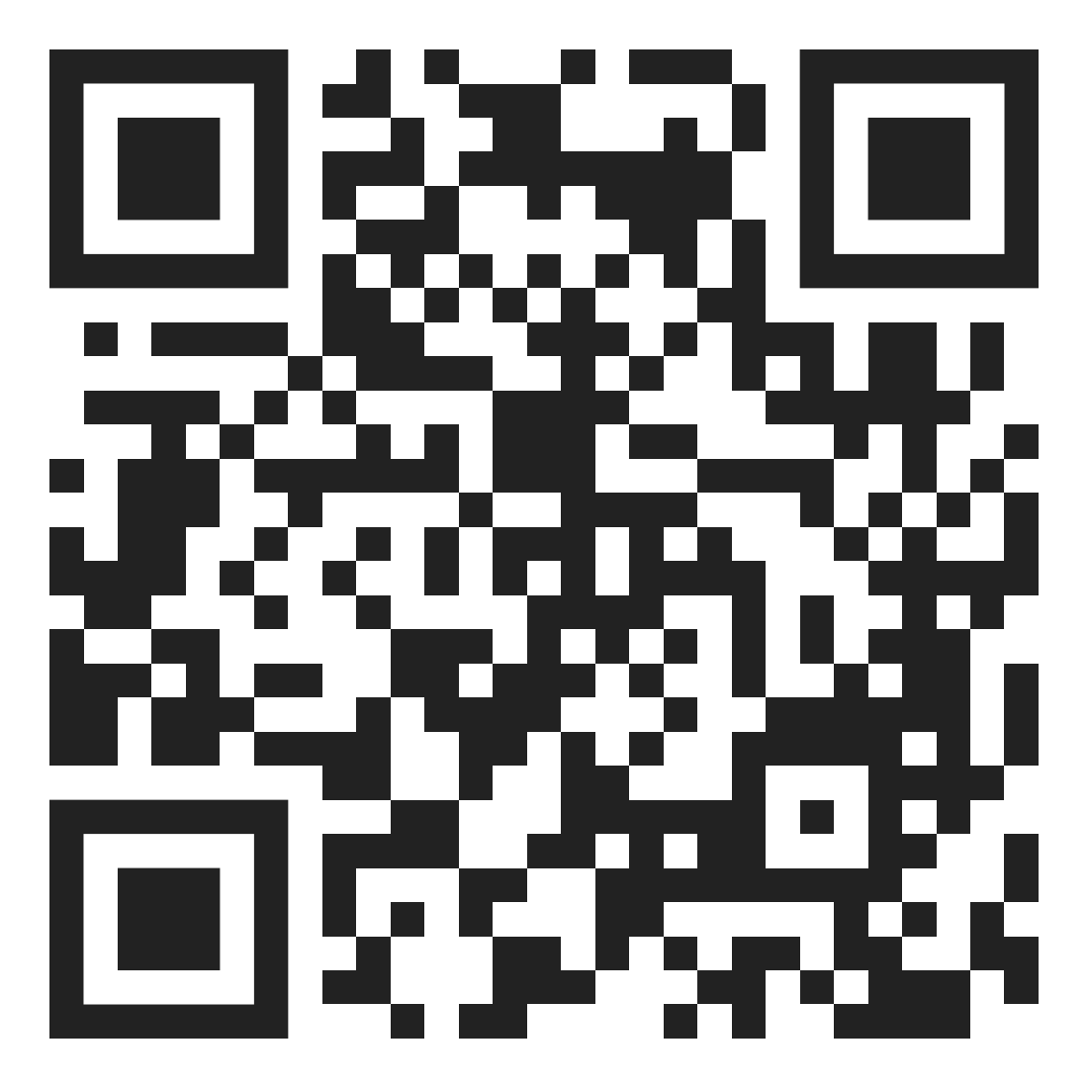
Sign up to be a Community Advocate
Help spread the mission of Concordia Language Villages at various events
Speak with prospective families to help answer questions about living the language experience
Educate school groups about our programs

Slide 4
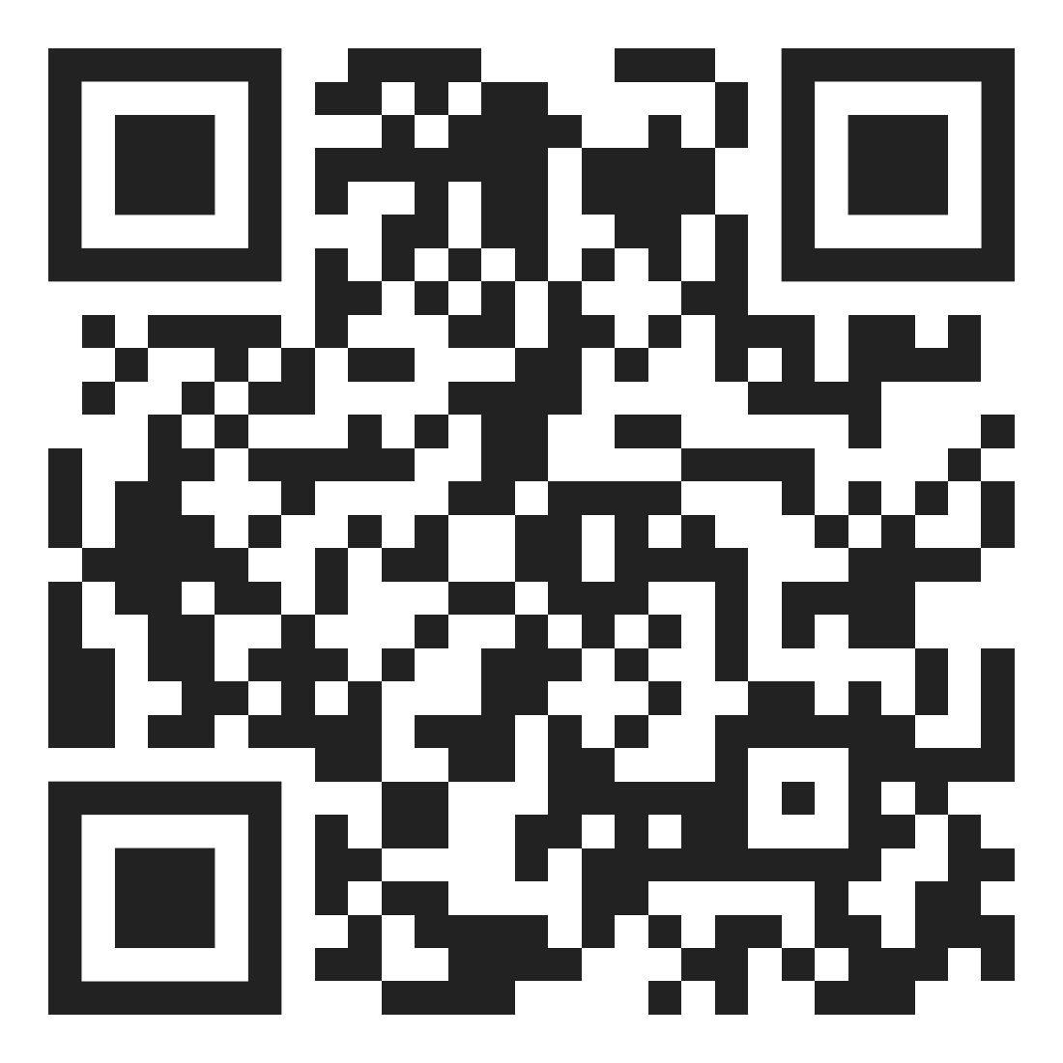
Scholarships Available for Youth & Adults

